Slide 1
Kern County Animal Services
Director’s Report
April 2023

Slide 2
Program Highlights
Foster
23 dogs, 31 puppies, 3 cats and 121 kittens entered the Department’s Foster Care Program for a total of 178 animals in the months of April 2023.
TNR
228 cats were spayed or neutered and released in April 2023. Since 2013, 17,674 cats have been spayed or neutered, and returned to field.
Adoption
177 dogs, 101 puppies, 21 cats, and 16 kittens under 5 months of age were adopted for a total of 315 animals adopted from Kern County Animal Shelters in April 2023.

Slide 3
Vaccination Clinics
April 2023
251 rabies
336 DHPP
33 FVRCP
97 Microchips

Slide 4
Spay/Neuter Program
Boron Clinic April 3rd:
24 Spay/Neuter Surgeries
Riverbed Clinic April 4th:
35 Spay/Neuter Surgeries
East Bakersfield Clinic April 10th:
40 Spay/Neuter Surgeries
Lake Isabella Clinic April 11th:
46 Spay/Neuter Surgeries
Boron Clinic April 18th:
25 Spay/Neuter Surgeries
Bakersfield April 19th:
45 Spay/Neuter Surgeries
Bakersfield April 22nd:
41 Spay/Neuter Surgeries
Riverbed Clinic April 24th:
26 Spay/Neuter Surgeries
East Bakersfield April 25th:
46 Spay/Neuter Surgeries
328 Spay/Neuter Surgeries Total

Slide 5
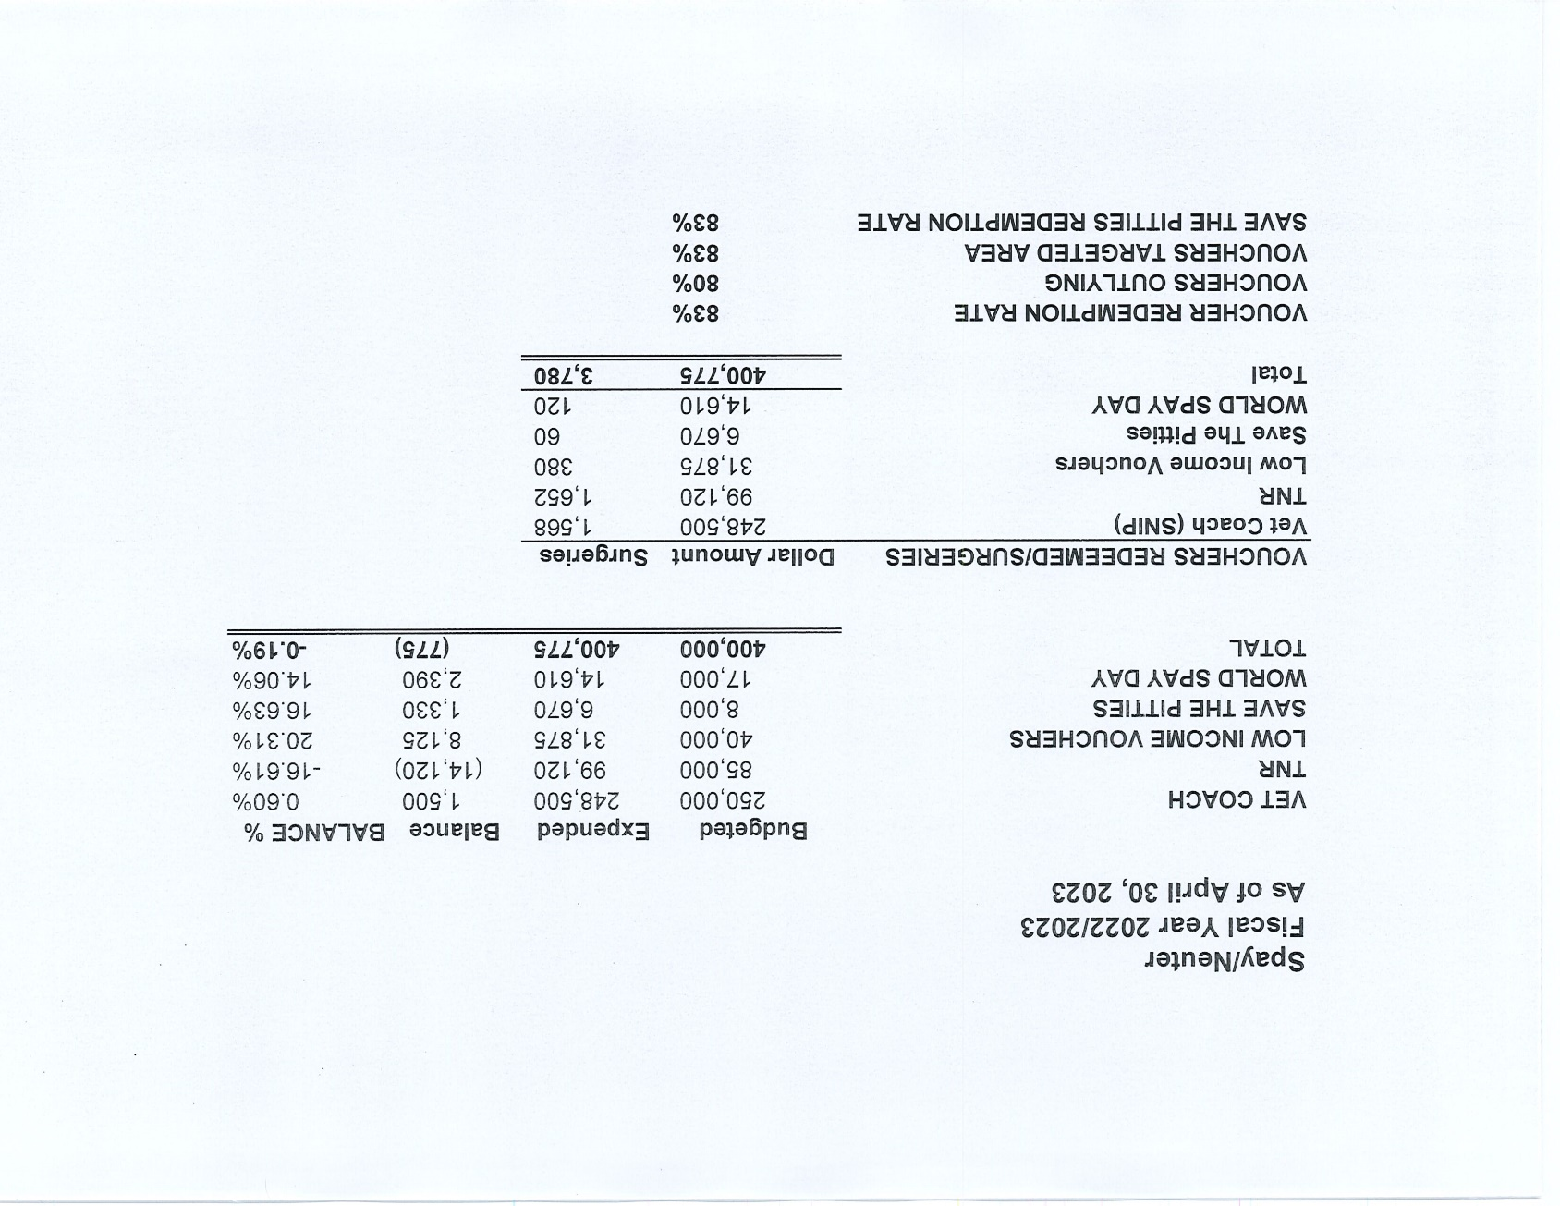

Slide 6
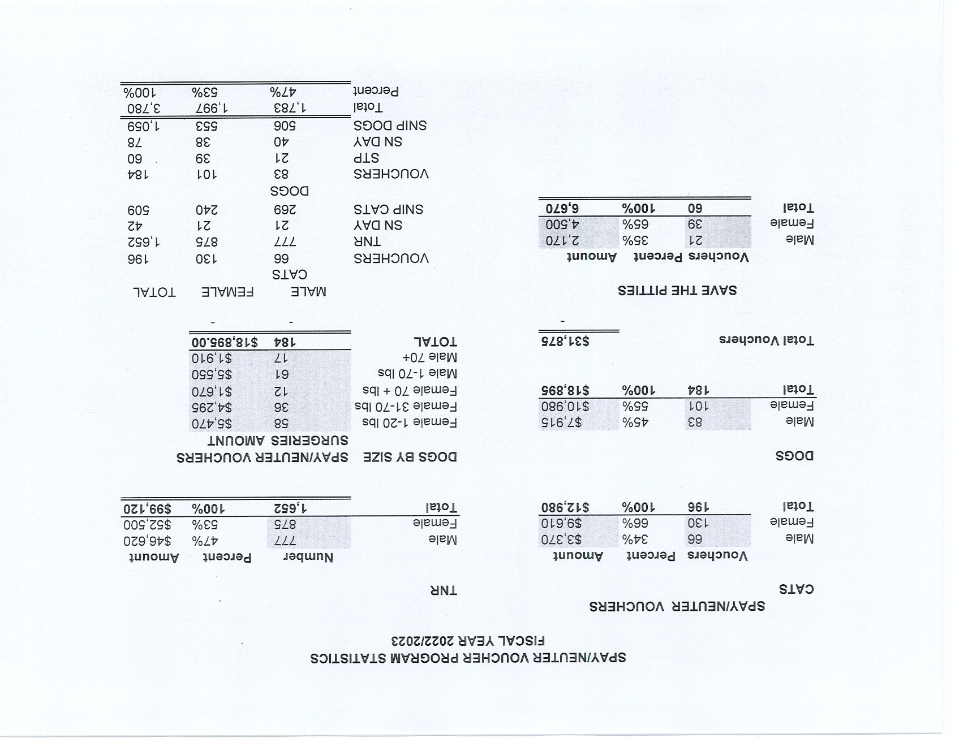

Slide 7
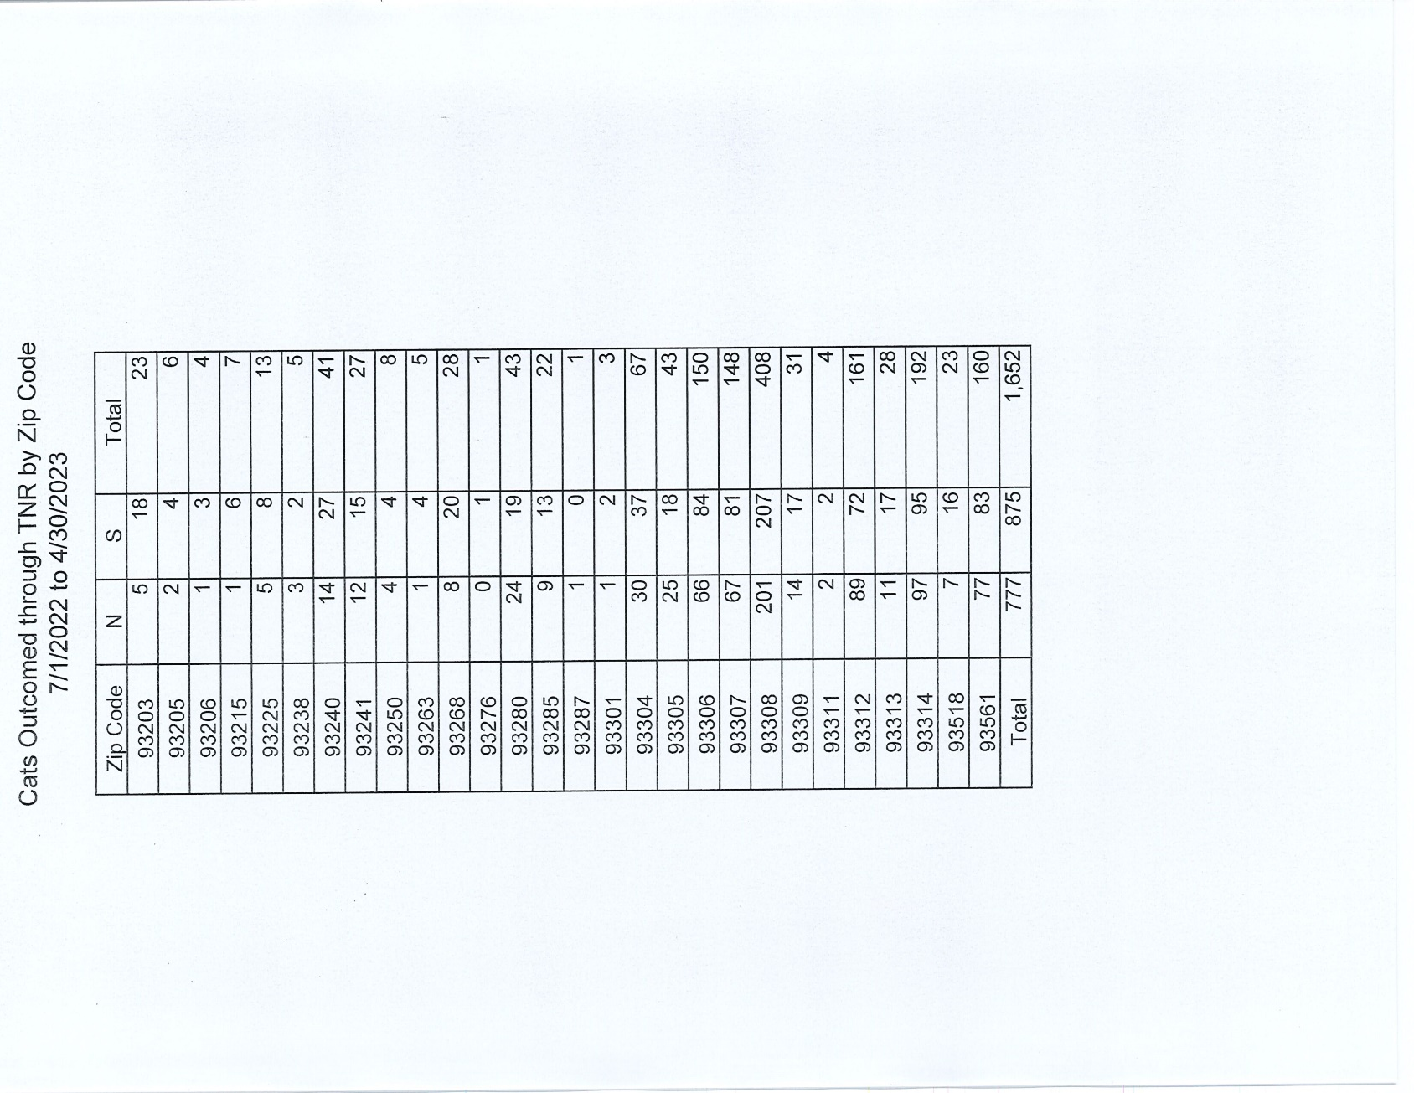

Slide 8
Adoptions Year To Date
753 dogs, 451 puppies under 5 months, 102 cats and 101 kittens under 5 months have been adopted.
Rescue Year To Date
457 dogs, 333 puppies under 5 months, 29 cats and 12 kittens under 5 months have been saved by Rescue partners.
Notes:
71

Slide 9
National Volunteer Appreciation Week

Slide 10
Streets of Bakersfield

Slide 11
Out In The Community…

Slide 12
Out In The Community…

Slide 13
Out In The Community…

Slide 14
Field Services
April 2023 | Calls Per Area
Lake Isabella | 85
Mojave | 100
North County | 57
Northeast | 333
Northwest | 254
Ridgecrest | 25
Southeast | 201
Southwest | 144
Taft | 86
Tehachapi | 61
Total | 1,346
94 dogs were returned to their owners in the field in April 2023.
99 dogs were secured on property by Animal Control Officers in April 2023.

Slide 15
Field Services-CAF
MARCH 2023 | Calls
CAF-Breeder | 19
CAF-Rescue | 0
CAF-Kennel | 2
CAF-Boarding | 0
Total | 21
0 Permits Issued/Inspections Passed
3 Inspection Failed
6 Citations Issued
54 Active CAF Permits

Slide 16
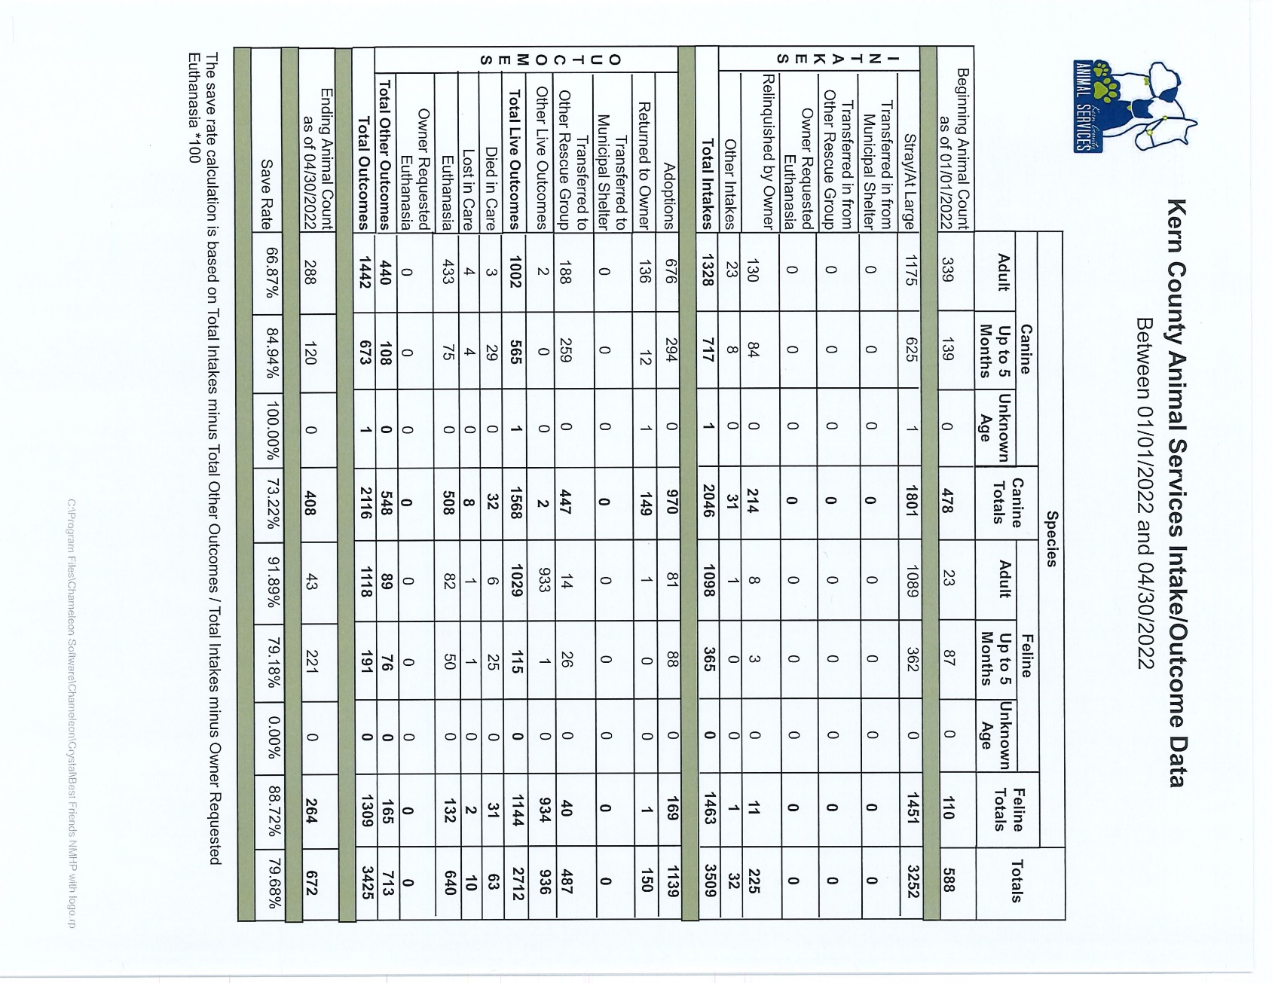

Slide 17
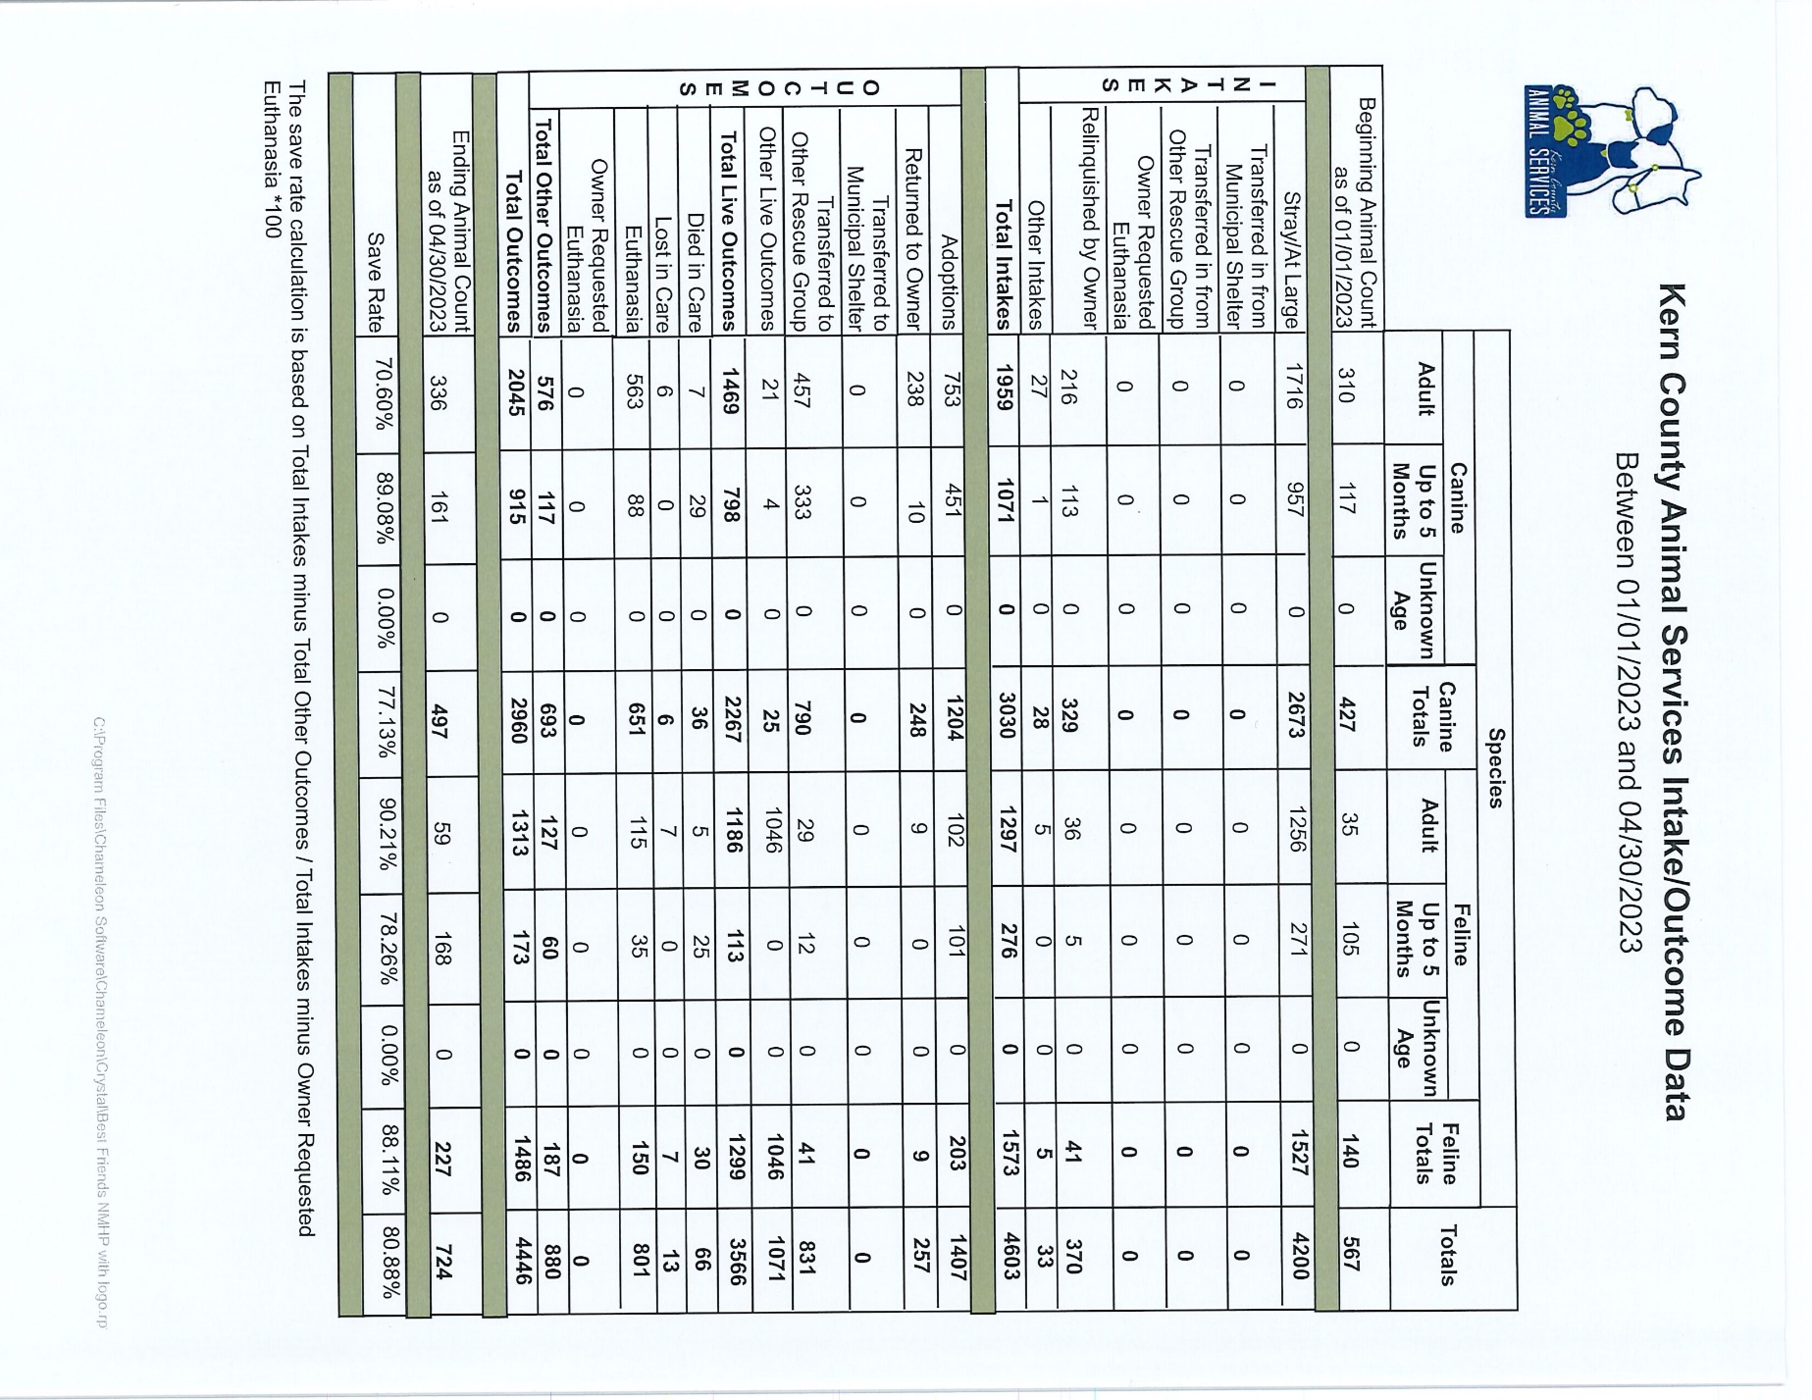

Slide 18
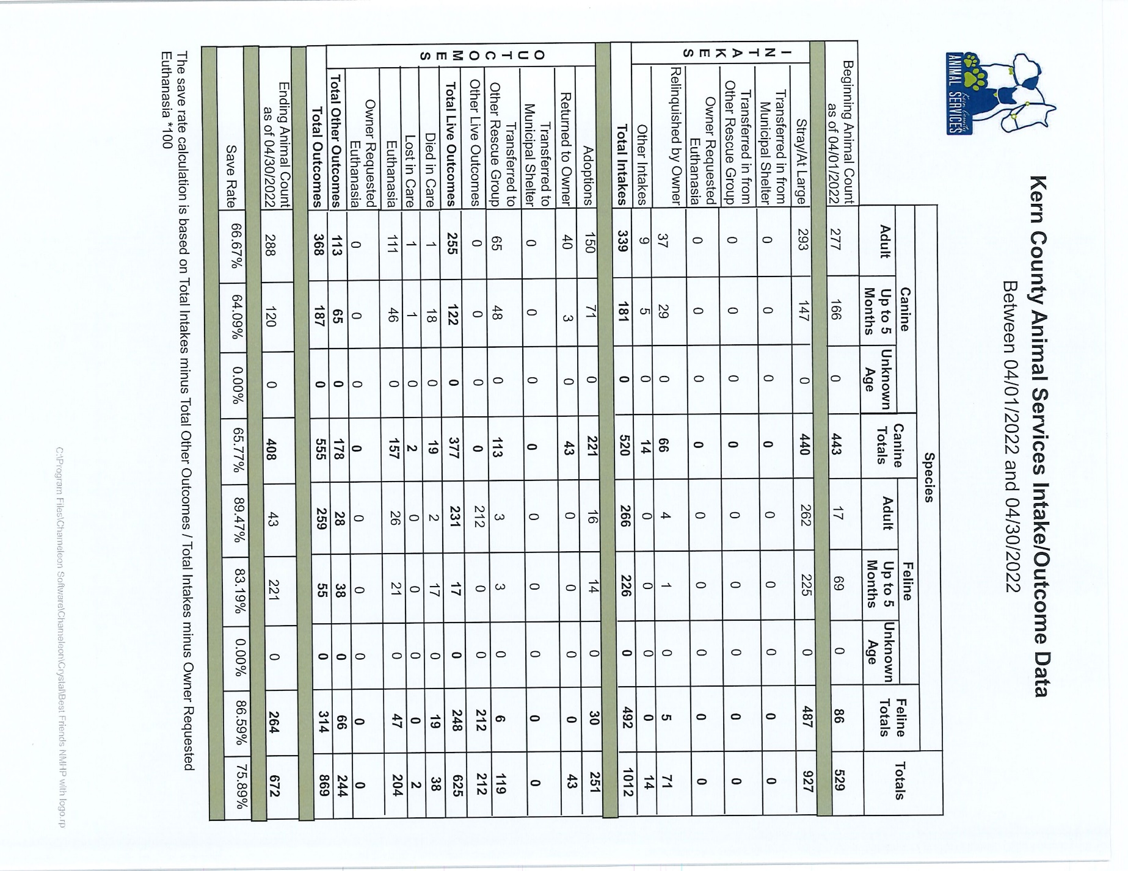

Slide 19
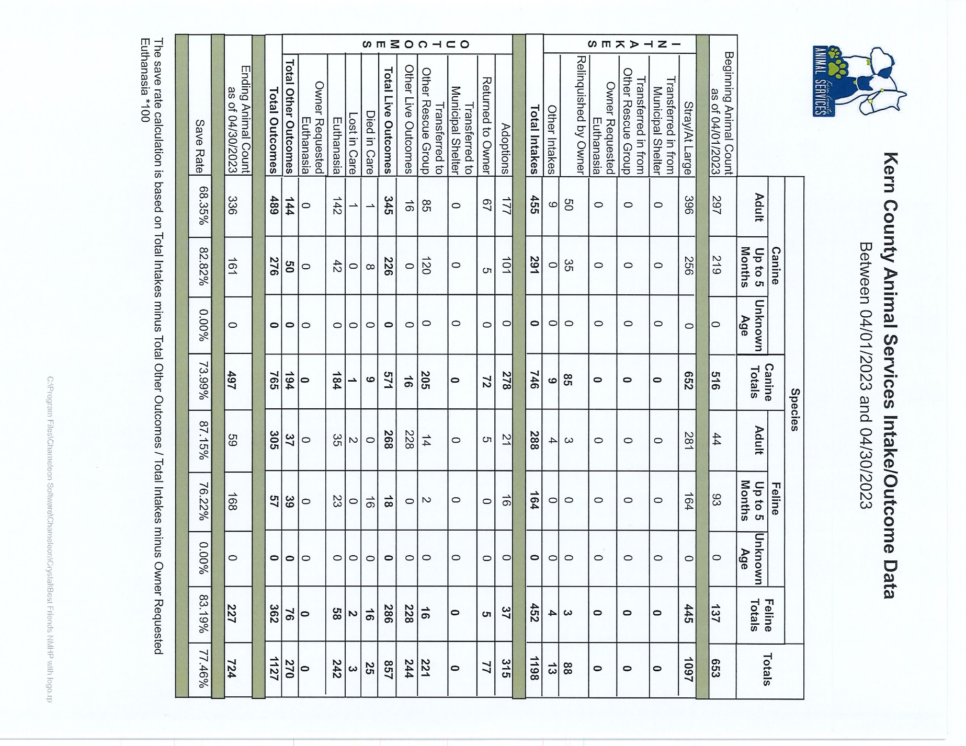

Slide 20
Volunteer Program
april 2023:
683.97 hours of service were donated
33 new volunteers
92 active volunteers
To date, 2094.49 hours of service have been donated

