Slide 1
Kern County Animal Services
Director’s Report
June 2022

Slide 2
Program Highlights
Foster
28 dogs, 64 puppies, 1 cat and 133 kittens and 6 rabbits entered the Department’s Foster Care Program for a total of 232 animals in the month of June 2022.
TNR
16 cats were spayed or neutered and released in June 2022. Since 2013, 16,000 cats have been spayed or neutered, and returned to field.
Adoption
172 dogs, 113 puppies, 9 cats, and 151 kittens under 5 months of age were adopted for a total of 445 animals adopted from Kern County Animal Shelters in June of 2022.

Slide 3
Vaccination Clinics
JUNE 2022
122 rabies
169 DHPP
21 FVRCP

Slide 4
Adoptions Year To Date
977 dogs, 466 puppies under 5 months, 104 cats and 331 kittens under 5 months have been adopted.
Rescue Year To Date
279 dogs, 347 puppies under 5 months, 19 cats and 52 kittens under 5 months have been saved by Rescue partners.
Notes:
71

Slide 5
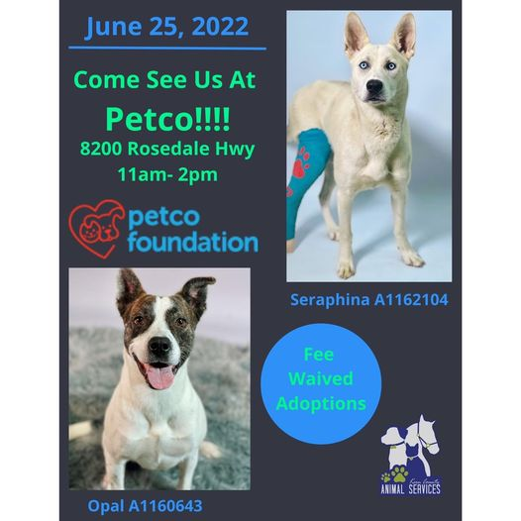
Adoption Promotions

Slide 6
Field Services
JUNE 2022 | Calls Per Area
Lake Isabella | 88
Mojave | 108
North County | 51
Northeast | 282
Northwest | 213
Ridgecrest | 18
Southeast | 173
Southwest | 146
Taft | 84
Tehachapi | 78
Total | 1,241
8 dogs were returned to their owners in the field in June 2022.
35 dogs were secured on property by Animal Control Officers in June 2022.

Slide 7
PET LICENSING WITH DOCUPET

Slide 8
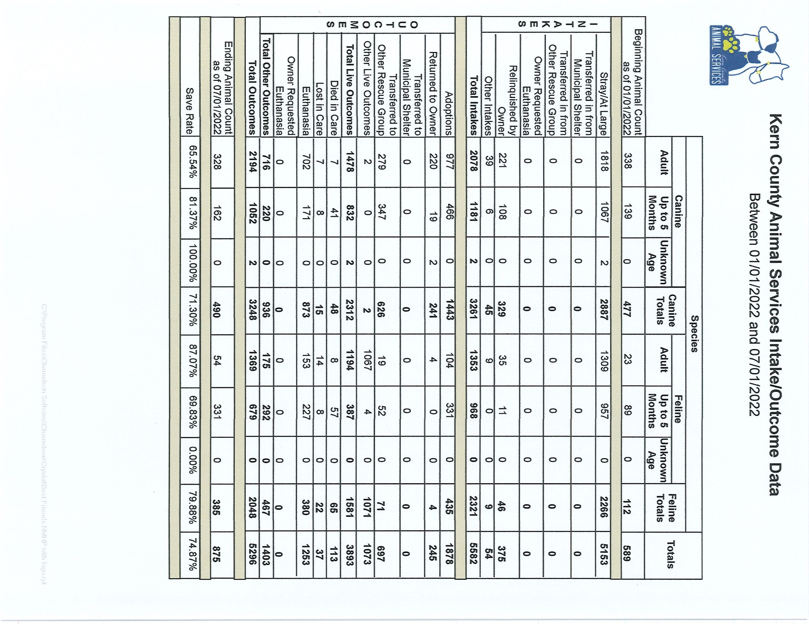

Slide 9
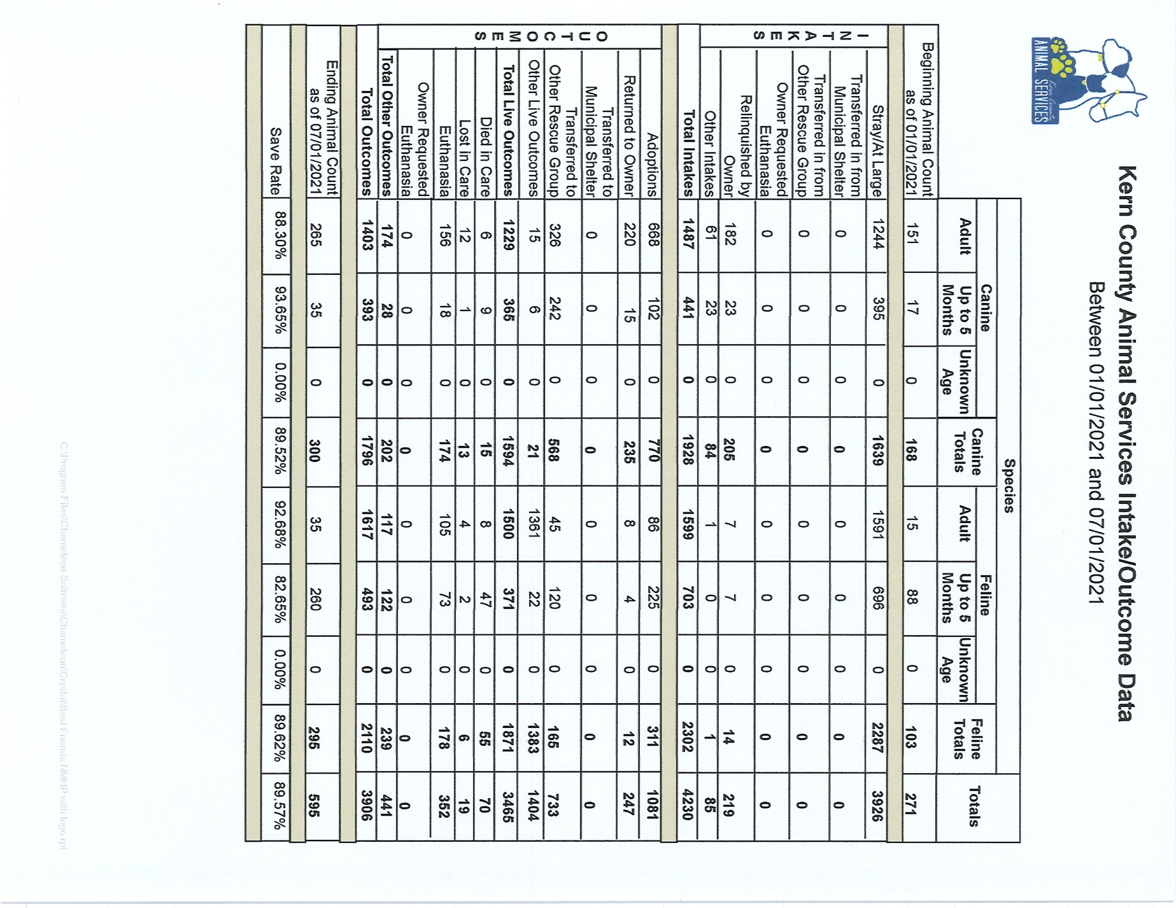

Slide 10
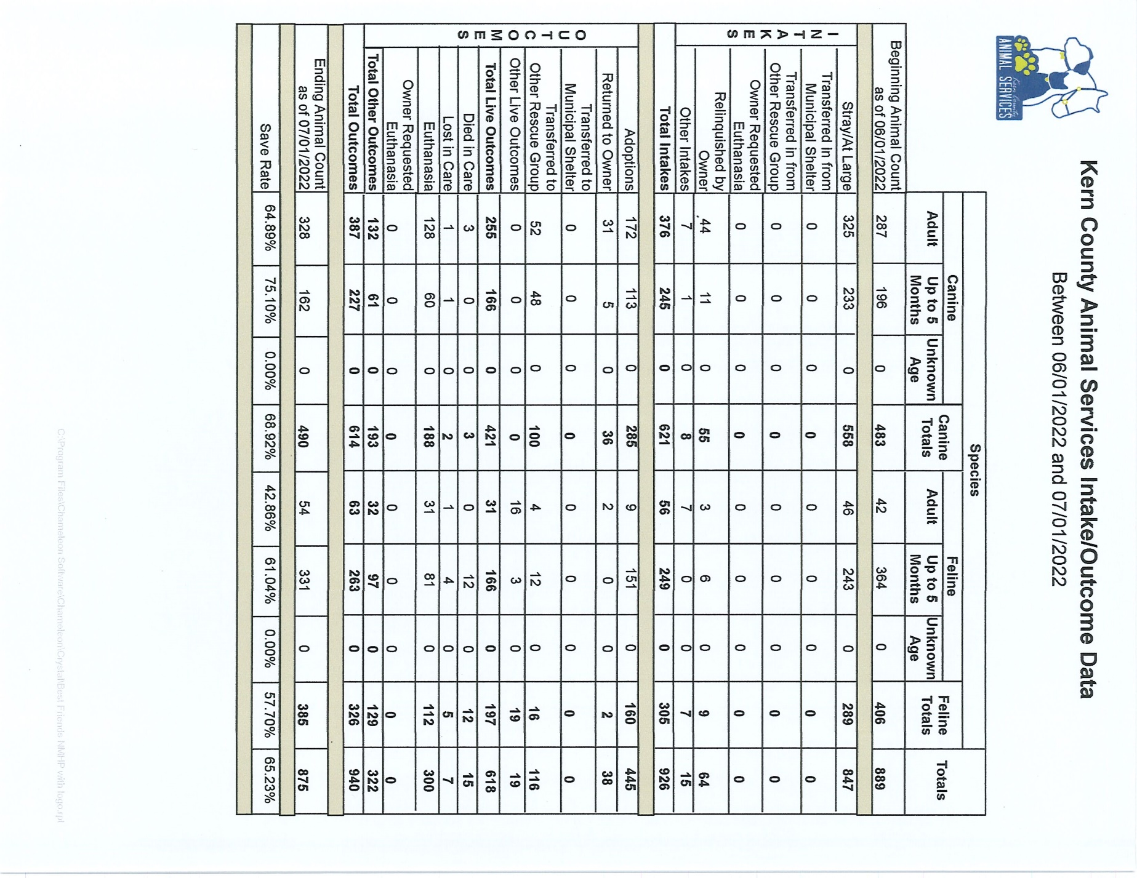

Slide 11
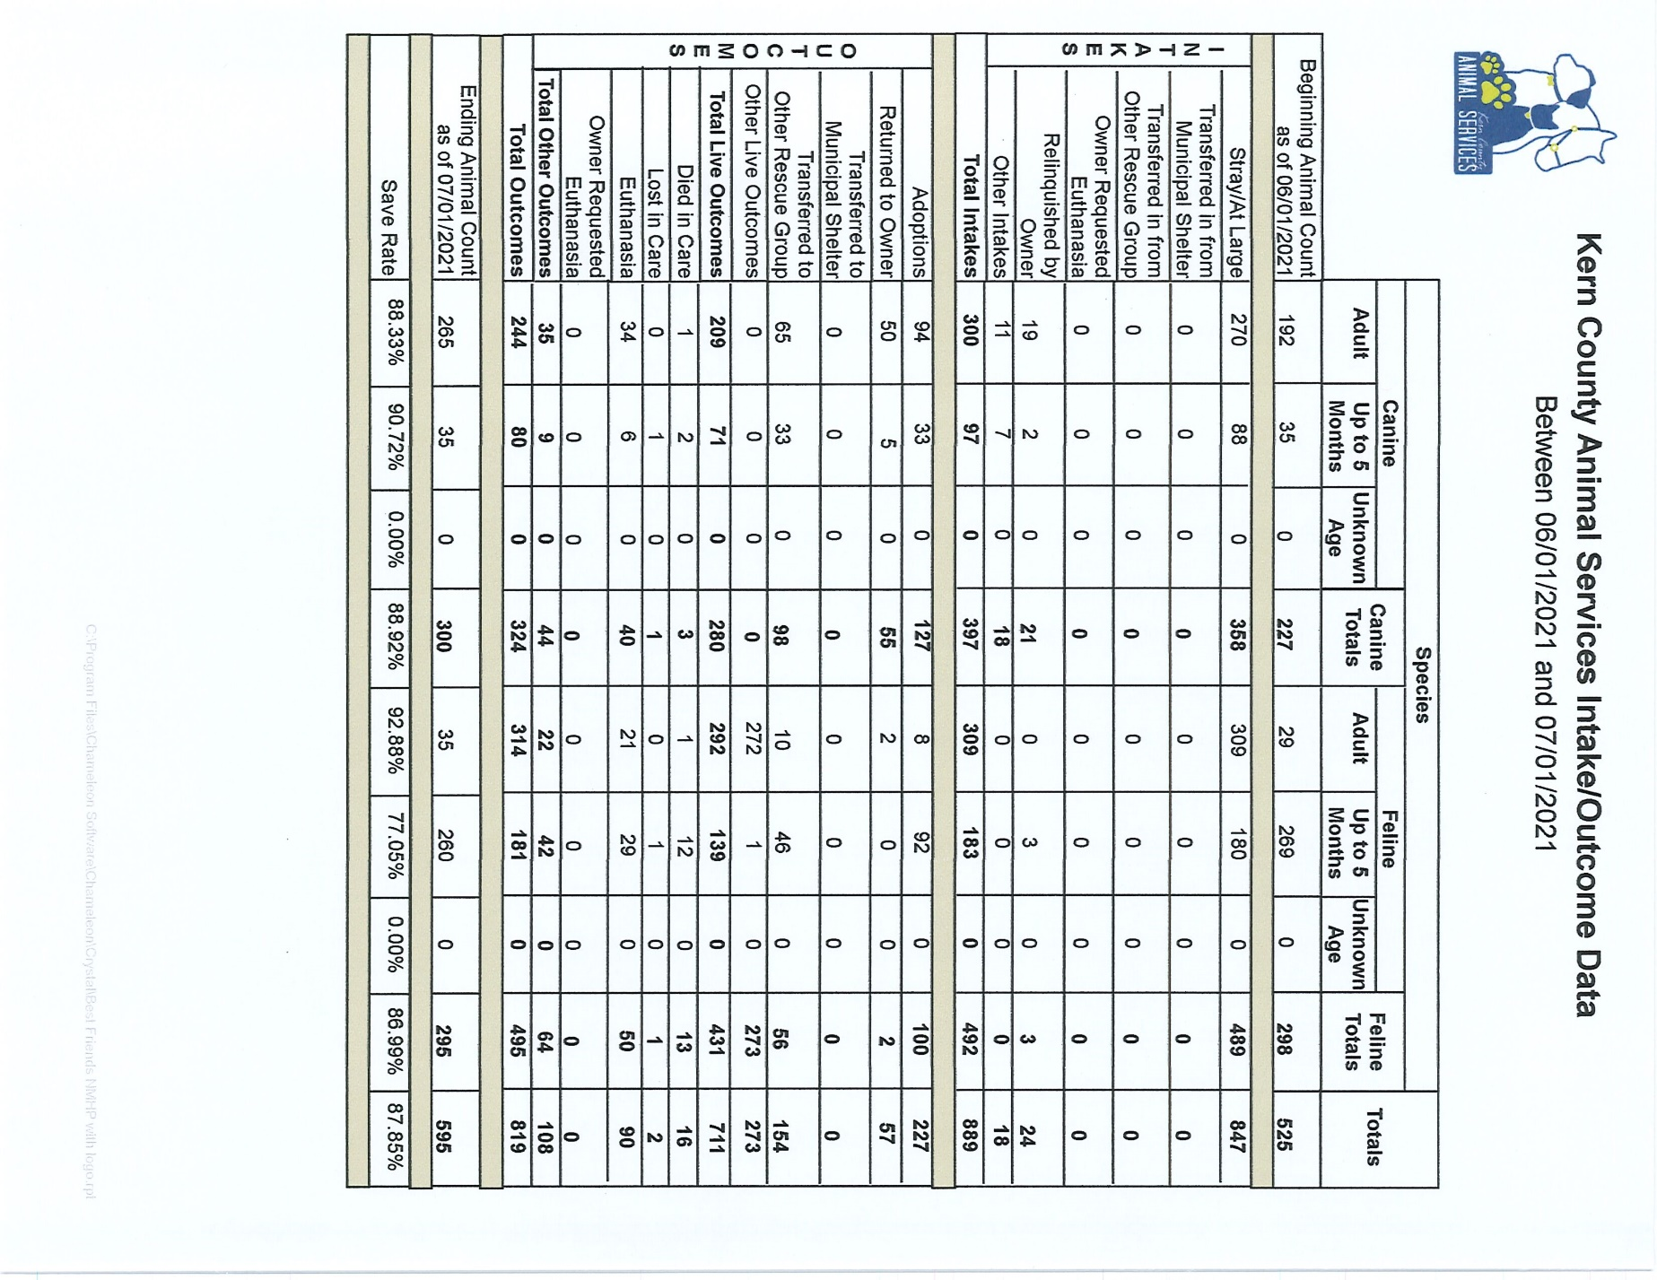

Slide 12
Volunteer Program
June 2022:
481.21 hours of service were donated
52 new volunteers
64 active volunteers

