Slide 1
Kern County Animal Services
Director’s Report
February 2022

Slide 2
Program Highlights
Foster
29 dogs, 53 puppies, 6 cats and 18 kittens entered the Department’s Foster Care Program for a total of 106 animals in February 2022.
TNR
291 cats were spayed or neutered and released in February 2022. Since 2013, 15,537 cats have been spayed or neutered, and returned to field.
Adoption
103 dogs, 48 puppies, 33 cats, and 24 kittens under 5 months of age were adopted for a total of 208 animals adopted from Kern County Animal Shelters in February of 2022.

Slide 3
Vaccination Clinics
113Rabies
102 DHPP
42 Microchips
5 Feline Vaccines

Slide 4
Adoptions Year To Date
253 dogs, 78 puppies under 5 months, 50 cats and 57 kittens under 5 months have been adopted.
Rescue Year To Date
84 dogs, 148 puppies under 5 months, 10 cats and 9 kittens under 5 months have been saved by Rescue partners.
Notes:
71

Slide 5
Adoption Promotions

Slide 6
Field Services
February 2022 | Calls Per Area
Lake Isabella | 67
Mojave | 91
North County | 55
Northeast | 246
Northwest | 204
Ridgecrest | 13
Southeast | 208
Southwest | 129
Taft | 93
Tehachapi | 64
Total | 1,170
12 dogs were returned to their owners in the field in February 2022.
60 dogs were secured on property by Animal Control Officers in February 2022.

Slide 7
Volunteer Program
February 2022:
442.3 hours of service were donated
44 new volunteers
85 active volunteers

Slide 8
THANK YOU CCADT!!

Slide 9
Reminder……

Slide 10
Reminder……

Slide 11
Home to Home

Slide 12
WORLD SPAY DAY TUESDAY FEBRUARY 22ND
115 Animals Altered

Slide 13
PET LICENSING WITH DOCUPET

Slide 14
Spay/Neuter Program
Mobile Clinic February 3rd & 4th:
112 Spay/Neuter Surgeries
Mobile Clinic February 17th & 18th:
103 Spay/Neuter Surgeries
Mobile Clinic February 22nd:
52 Spay/Neuter Surgeries
Mobile Clinics Beyond February:
March 10th, 11th in East Bakersfield, 17th and 18th in Lamont and the 26th in Boron
Buttonwillow/Lost Hills in April
Taft and Lake Isabella in May
Tehachapi in June

Slide 15
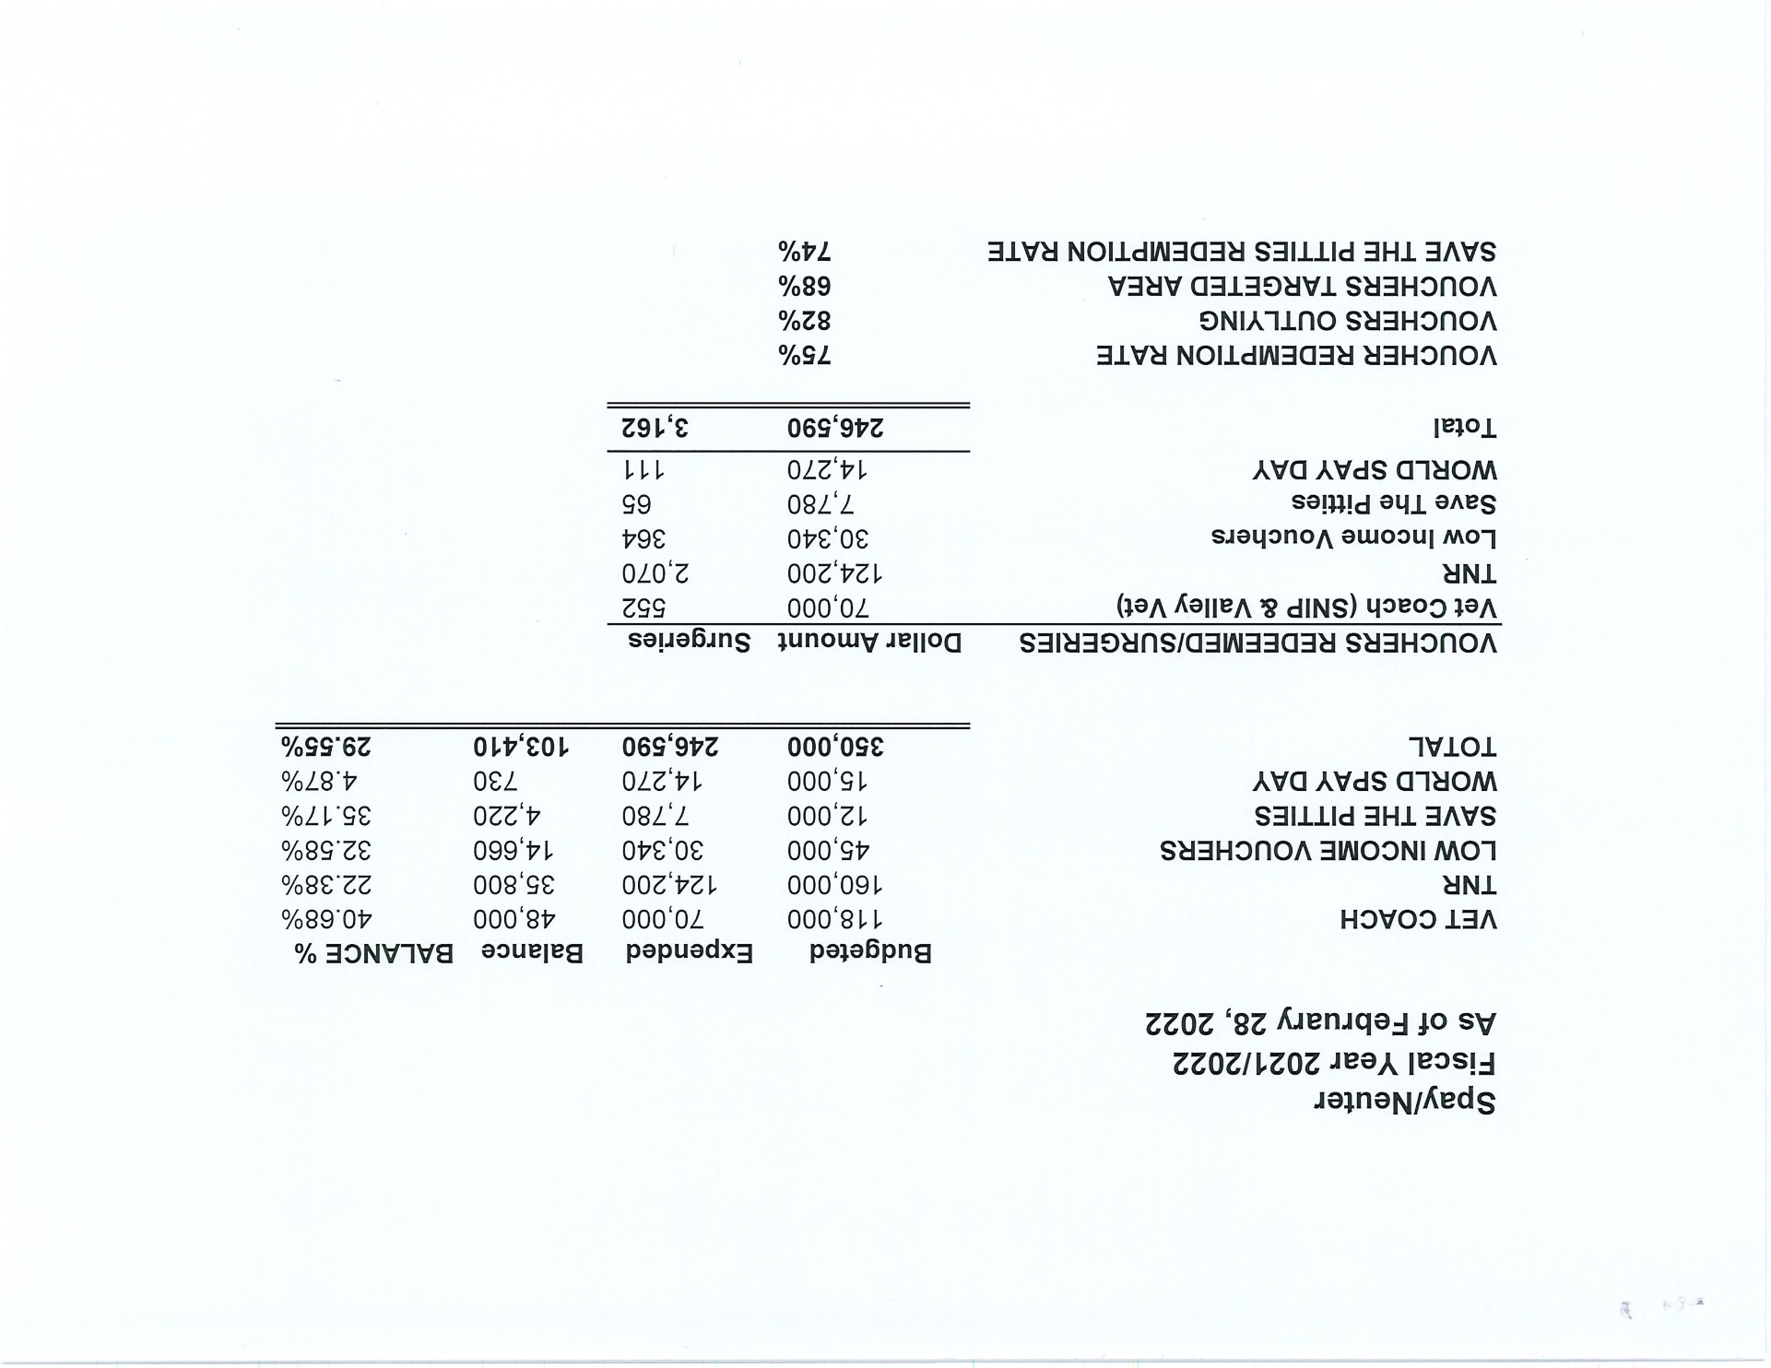

Slide 16
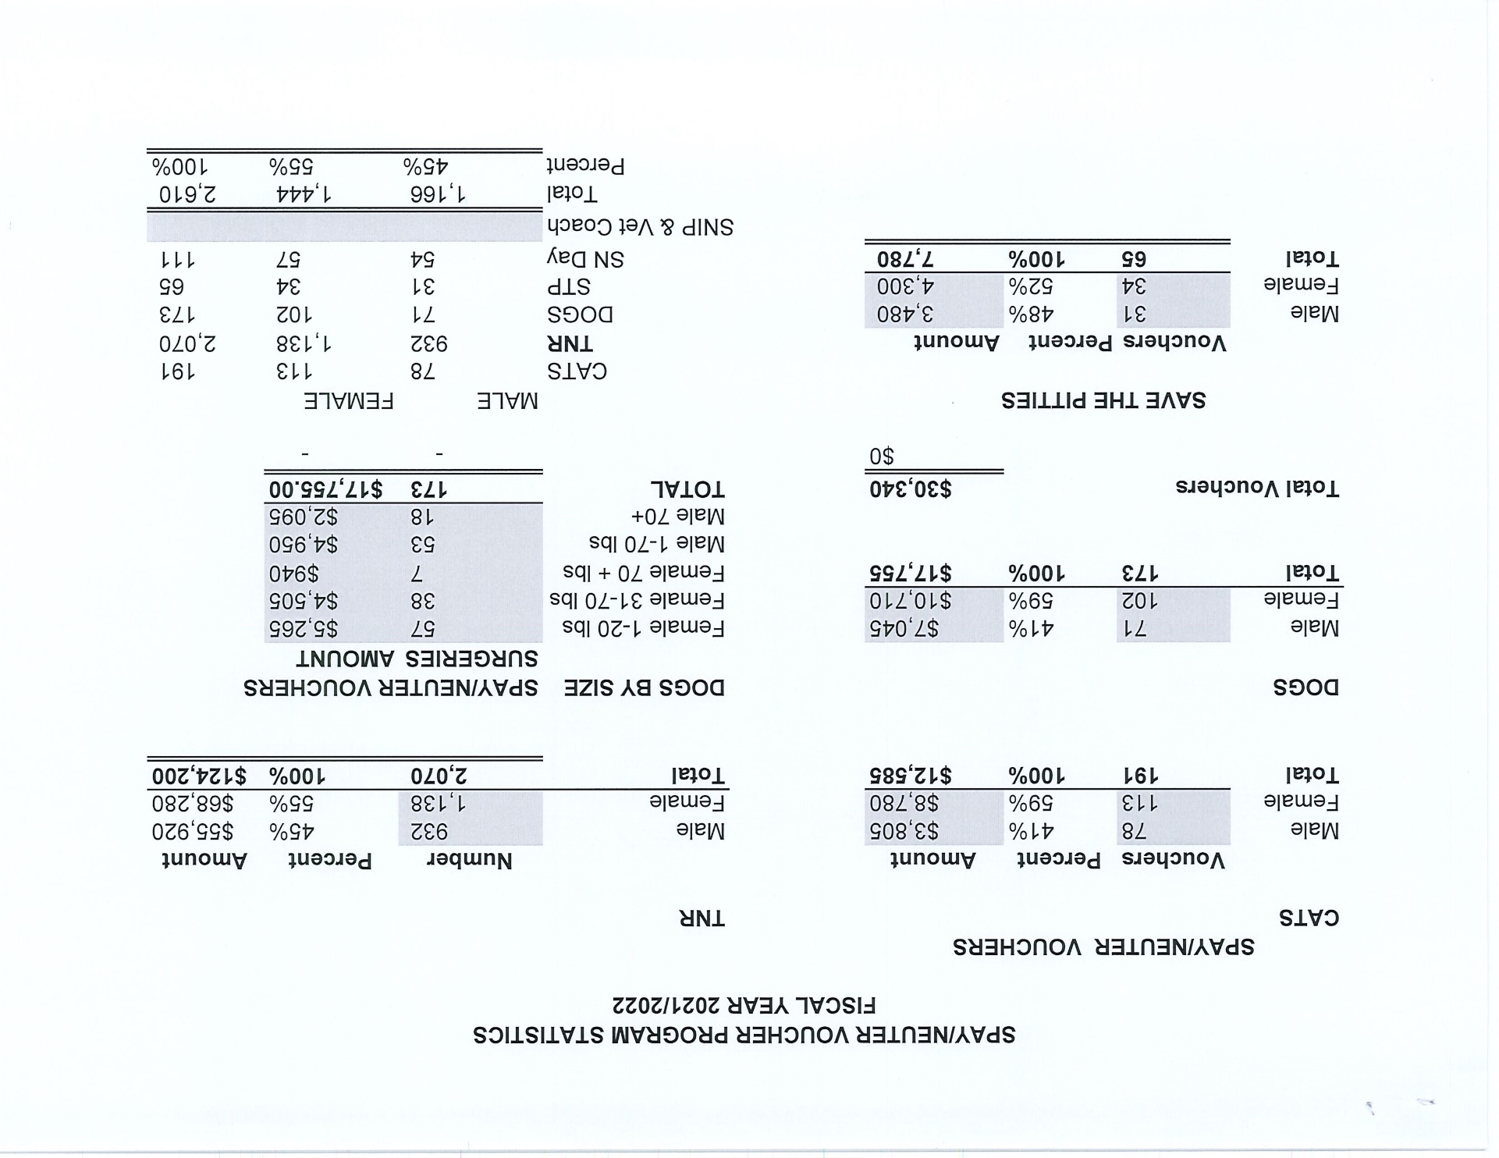

Slide 17
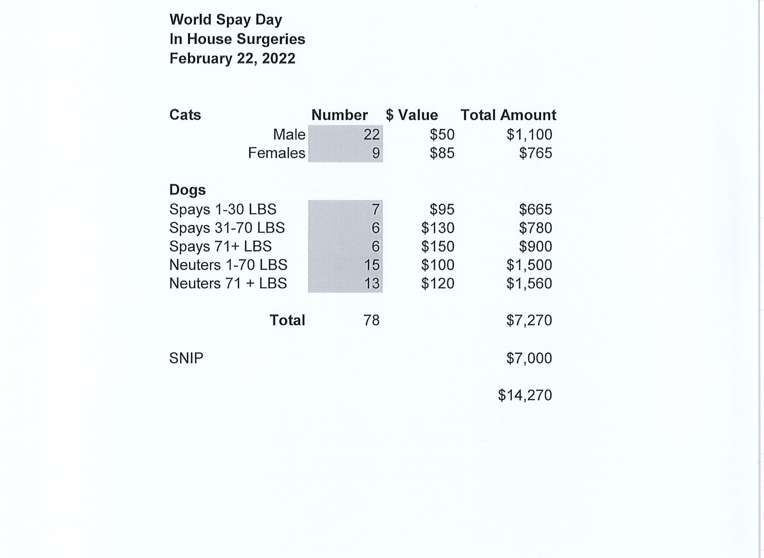

Slide 18
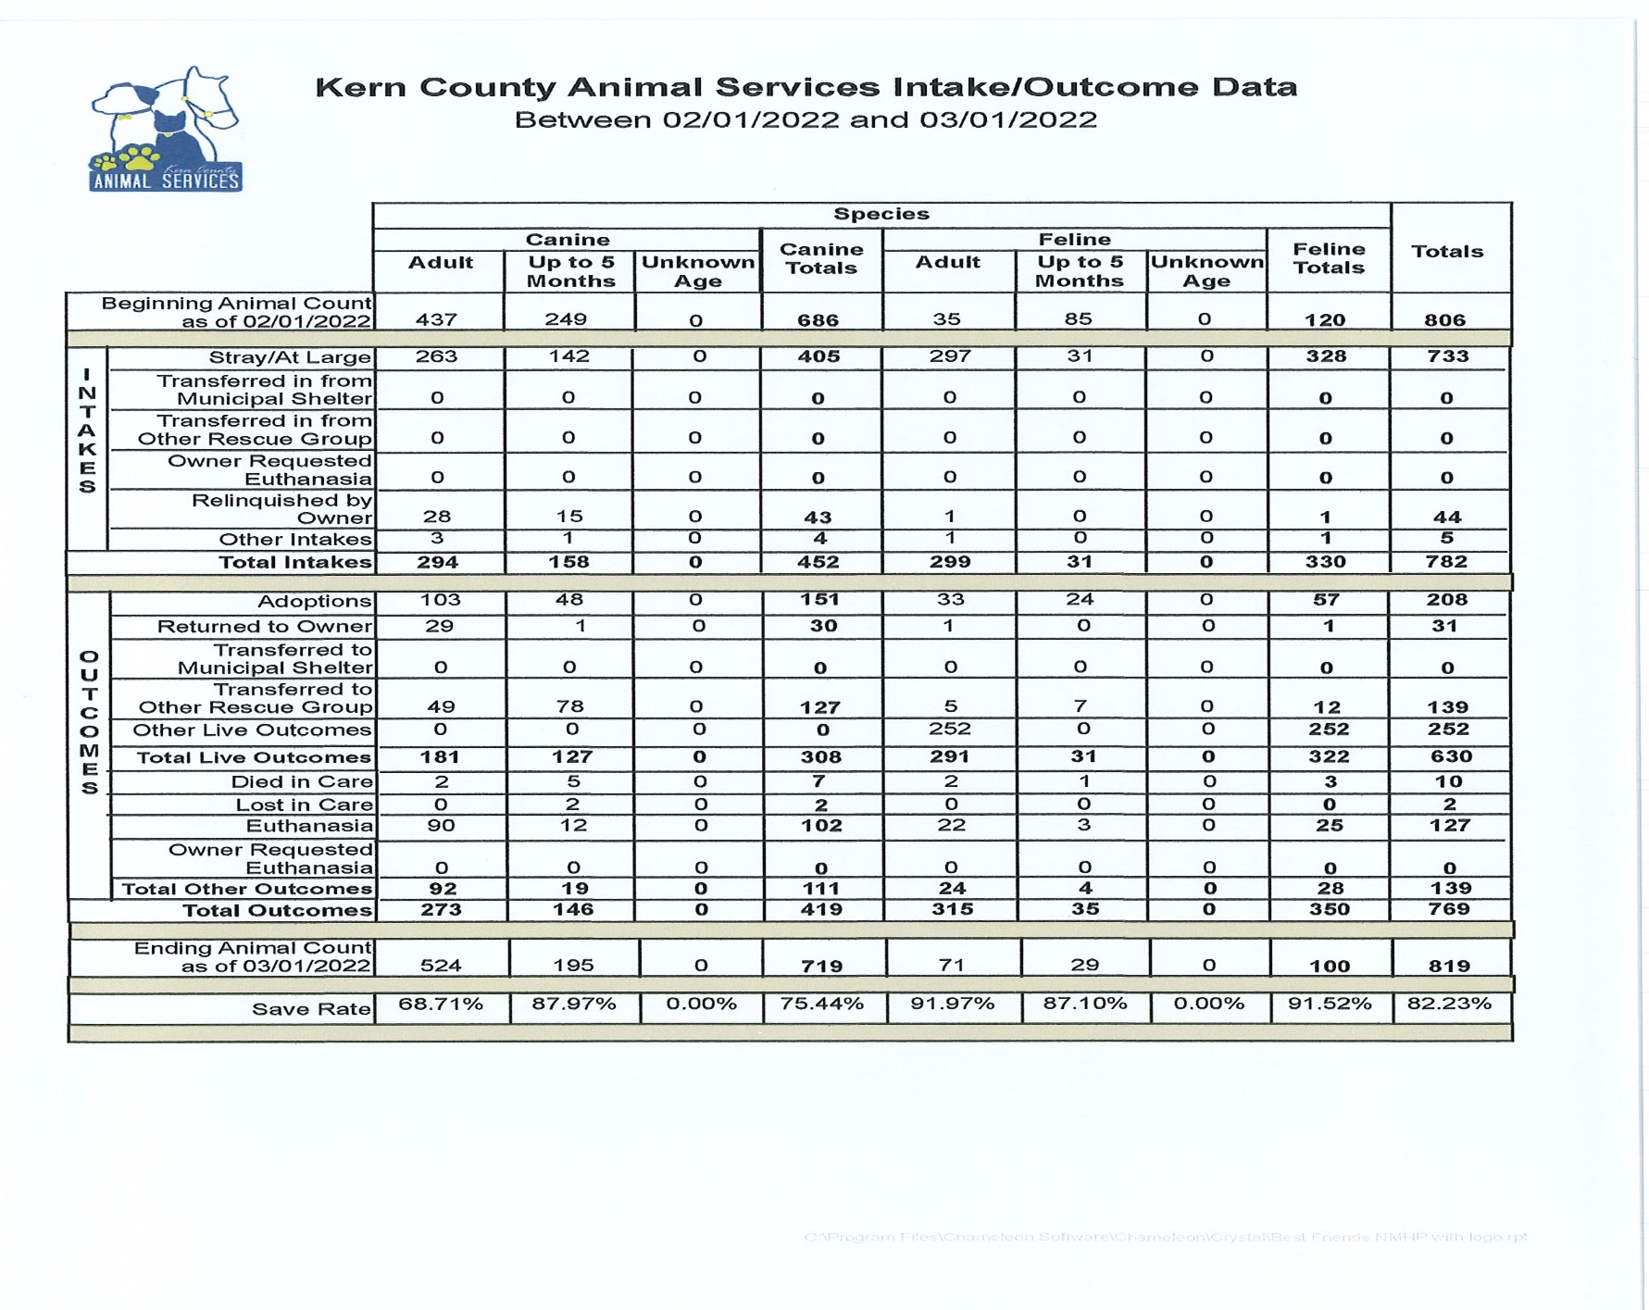

Slide 19
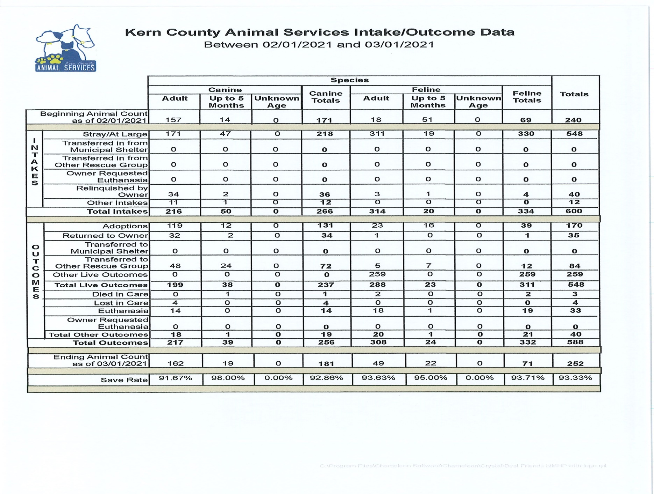

Slide 20
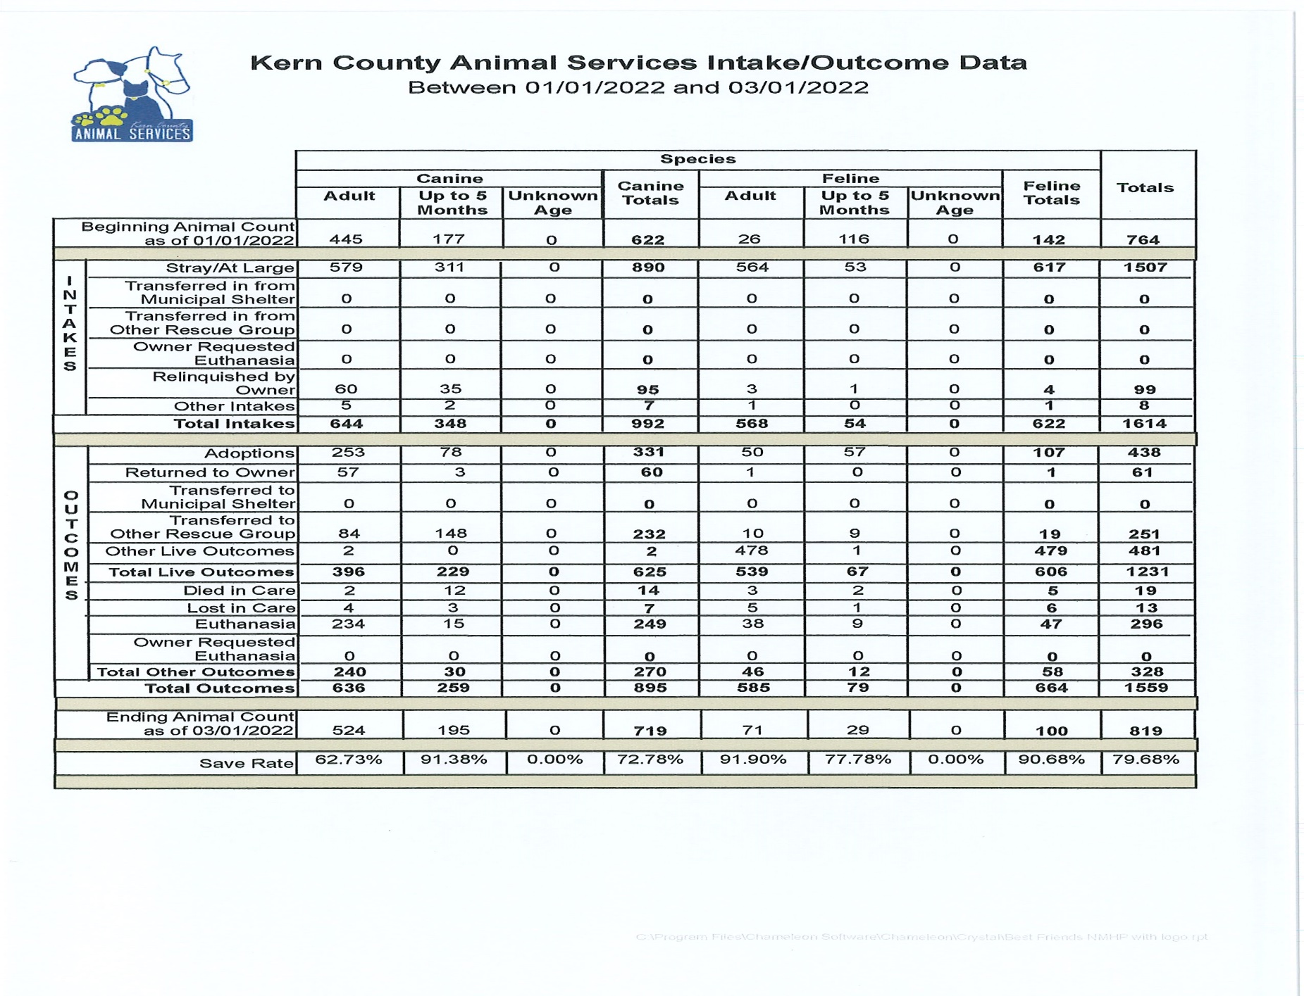

Slide 21
